Slide 1
LISTS

Slide 2
WORKING WITH LISTS
HTML offers web authors three ways for specifying lists of information. All lists must contain one or more list elements. Lists may contain −
<ul> − An unordered list. This will list items using plain bullets.
<ol> − An ordered list. This will use different schemes of numbers to list your items.
<dl> − A definition list. This arranges your items in the same way as they are arranged in a dictionary.

Slide 3
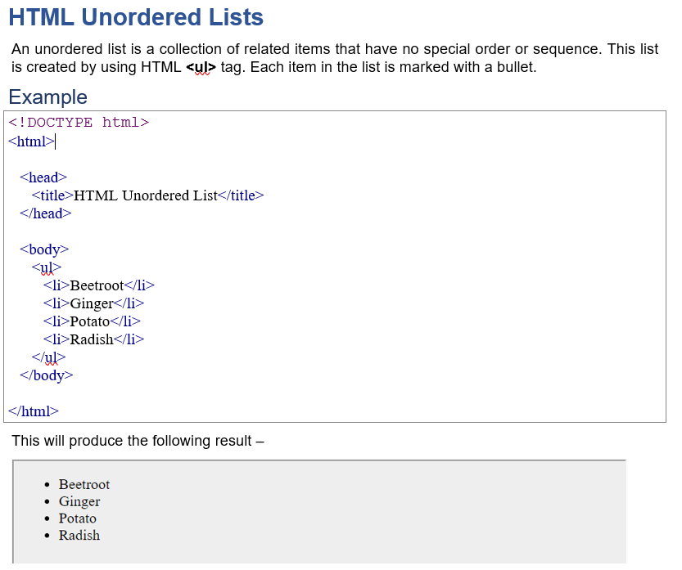

Slide 4
The type Attribute
You can use type attribute for <ul> tag to specify the type of bullet you like. By default, it is a disc. Following are the possible options −
<ul type = "square">
<ul type = "disc">
<ul type = "circle">
Example

Slide 5
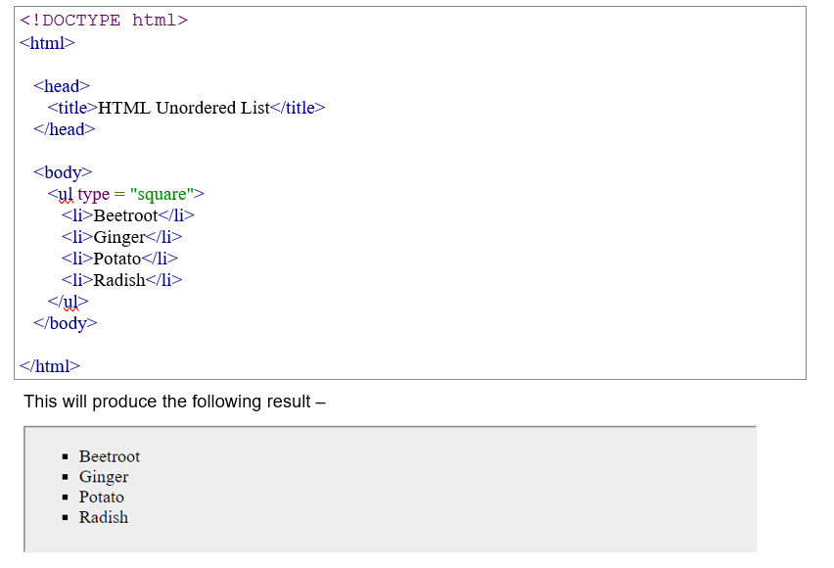

Slide 6
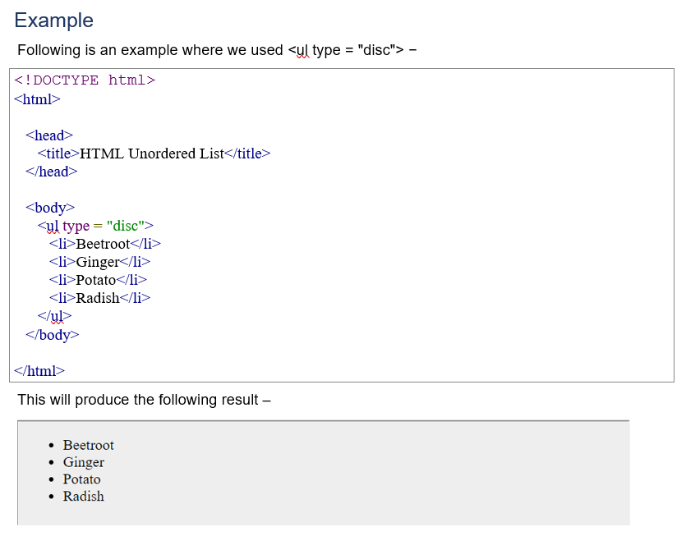

Slide 7
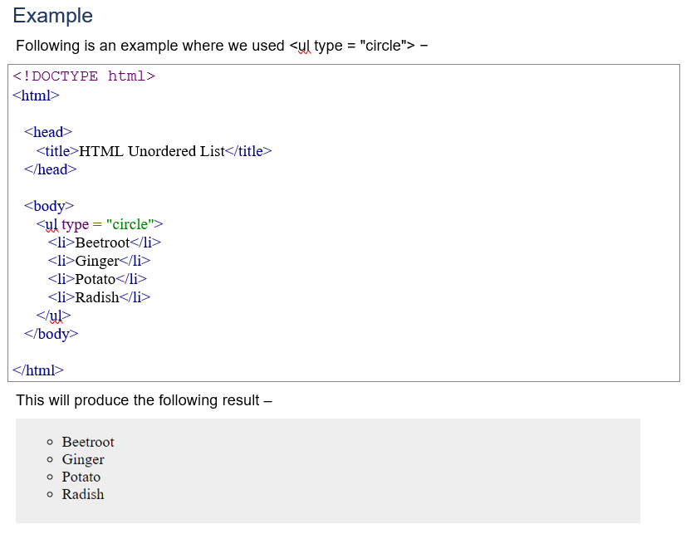

Slide 8
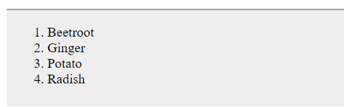
HTML Ordered Lists
Example
<!DOCTYPE html>
<html>
<head>
<title>HTML Ordered List</title>
</head>
<body>
<ol>
<li>Beetroot</li>
<li>Ginger</li>
<li>Potato</li>
<li>Radish</li>
</ol>
</body>
</html>
If you are required to put your items in a numbered list instead of bulleted, then HTML ordered list will be used. This list is created by using <ol> tag. The numbering starts at one and is incremented by one for each successive ordered list element tagged with <li>.

Slide 9
The type Attribute
You can use type attribute for <ol> tag to specify the type of numbering you like. By default, it is a number. Following are the possible options −
<ol type = "1"> - Default-Case Numerals.
<ol type = "I"> - Upper-Case Numerals.
<ol type = "i"> - Lower-Case Numerals.
<ol type = "A"> - Upper-Case Letters.
<ol type = "a"> - Lower-Case Letters

Slide 10
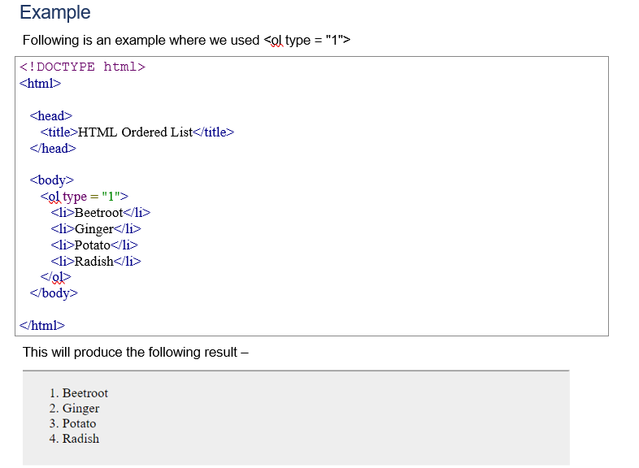

Slide 11
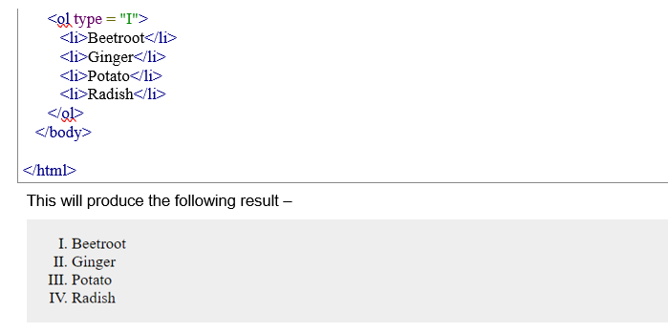

Slide 12
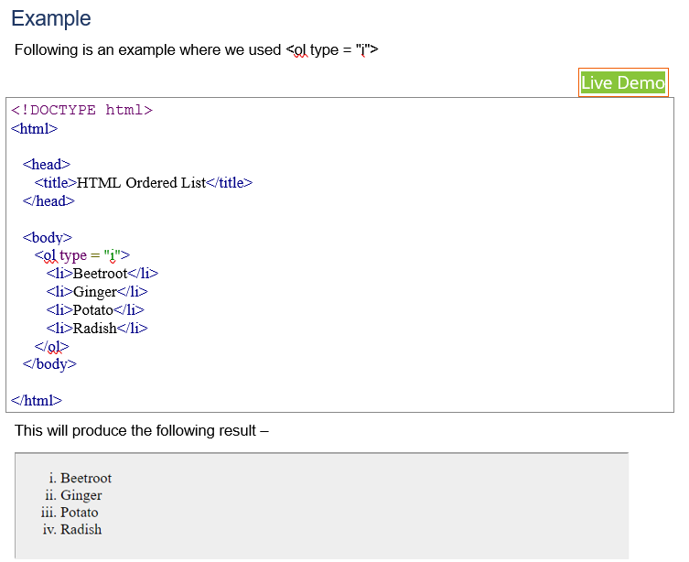

Slide 13
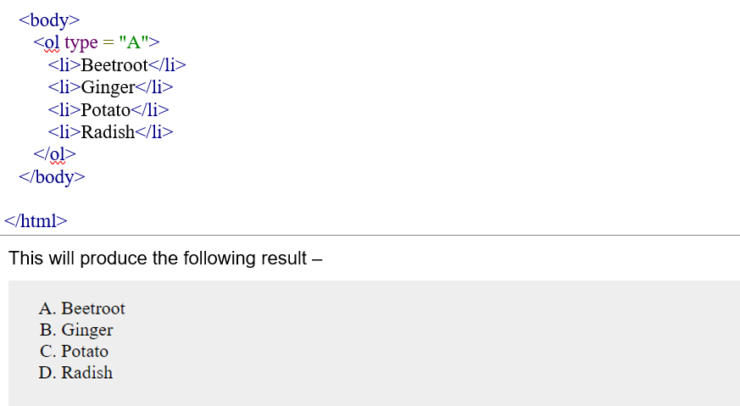

Slide 14
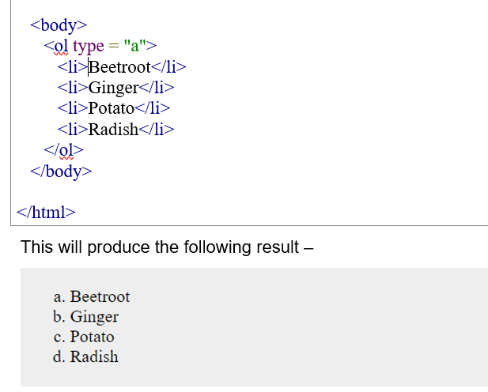

Slide 15
The start Attribute
You can use start attribute for <ol> tag to specify the starting point of numbering you need. Following are the possible options −
<ol type = "1" start = "4"> - Numerals starts with 4.
<ol type = "I" start = "4"> - Numerals starts with IV.
<ol type = "i" start = "4"> - Numerals starts with iv.
<ol type = "a" start = "4"> - Letters starts with d.
<ol type = "A" start = "4"> - Letters starts with D.

Slide 16
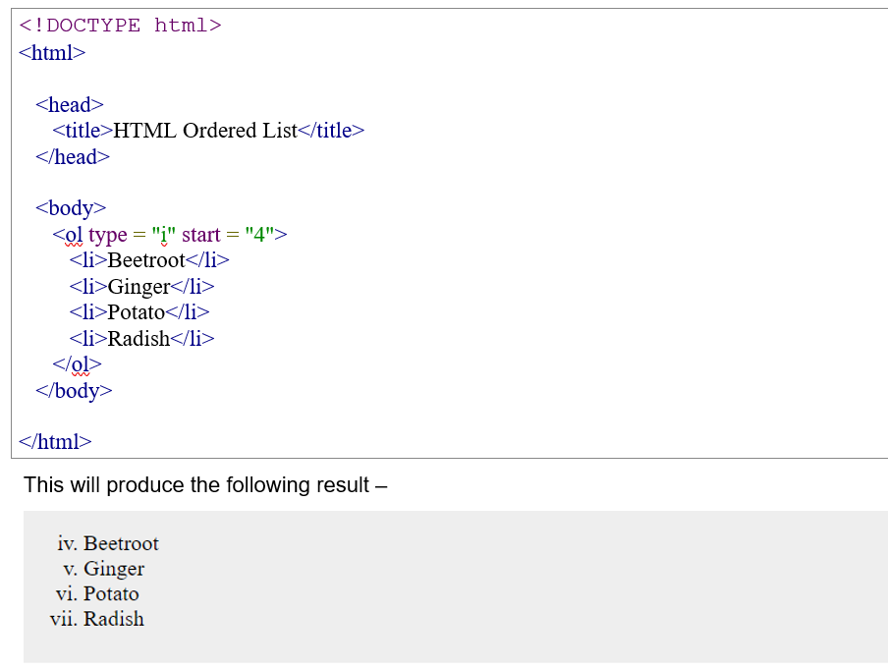

Slide 17
HTML Definition Lists
HTML and XHTML supports a list style which is called definition lists where entries are listed like in a dictionary or encyclopedia. The definition list is the ideal way to present a glossary, list of terms, or other name/value list.
Definition List makes use of following three tags.
<dl> − Defines the start of the list
<dt> − A term
<dd> − Term definition
</dl> − Defines the end of the list

Slide 18
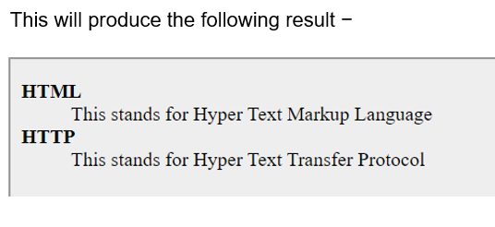
<!DOCTYPE html>
<html>
<head>
<title>HTML Definition List</title>
</head>
<body>
<dl>
<dt><b>HTML</b></dt>
<dd>This stands for Hyper Text Markup Language</dd>
<dt><b>HTTP</b></dt>
<dd>This stands for Hyper Text Transfer Protocol</dd>
</dl>
</body>
</html>

Slide 19
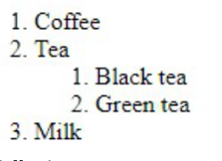
Nested ordered list
Nested ordered list, a nested ordered list is a list that has a list inside another list.

Slide 21
Frames
Frames for designing a good website:
HTML Frames are used to divide the web browser window into multiple sections where each section can be loaded separately. A frameset tag is the collection of frames in the browser window.
Creating Frames: Instead of using body tag, use frameset tag in HTML to use frames in web browser. But this Tag is deprecated in HTML 5. The frameset tag is used to define how to divide the browser. Each frame is indicated by frame tag and it basically defines which HTML document shall open into the frame. To define the horizontal frames use row attribute of frame tag in HTML document and to define the vertical frames use col attribute of frame tag in HTML document.

Slide 22
The <frameset> Tag
To create a frameset document, you begin with the <frameset> tag. When used in an HTML document, the <frameset> tag replaces the <body> tag, as shown in the following code:
<html>
<head>
<title>Page Title</title>
</head>
<frameset>
.. your frameset goes here ...
</frameset>
</html>
It's important that you understand up front how a frameset document differs from a normal HTML document. If you include a <frameset> tag in an HTML document, you cannot include a <body> tag also.

Slide 23

The cols Attribute
When you define a <frameset> tag, you must include one of two attributes as part of the tag definition. The first of these attributes is the cols attribute, which takes the following form:
<frameset cols="column width, column width, ...">
Input
<html>
<head>
<title>Three Columns</title>
</head>
<frameset rows = "20%, 60%, 20%">
<frame name = "top" src = "C:/Users/dharam/Desktop/attr1.png" />
<frame name = "main" src = "C:/Users/dharam/Desktop/gradient3.png" />
<frame name = "bottom" src = "C:/Users/dharam/Desktop/col_last.png" />
</frameset>
</html>

Slide 24

The rows Attribute
The rows attribute works the same as the cols attribute, except that it splits the screen into horizontal frames rather than vertical ones. To split the screen into two frames of equal height, you would write the following:
Input
<html>
<head>
<title>Two Rows</title>
</head>
<frameset cols = "30%, 40%, 30%">
<frame name = "top" src = "C:/Users/dharam/Desktop/attr1.png" />
<frame name = "main" src = "C:/Users/dharam/Desktop/gradient3.png" />
<frame name = "bottom" src = "C:/Users/dharam/Desktop/col_last.png" />
</frameset>
</html>

Slide 26
drawbacks
There are few drawbacks also you should be aware of with frames are as follows:
Some browsers do not print well from framesets.
Some smaller devices cannot cope with frames, often because their screen is not big enough to be divided up.
Some time your page will be displayed differently on different computers due to different screen resolution.
The browser's back button might not work as the user hopes.
There are still few browsers who do not support frame technology.

Slide 27
HTML <iframe> Tag
The <iframe> tag specifies an inline frame.
An inline frame is used to embed another document within the current HTML document.
<!DOCTYPE html>
<html>
<body>
<h1>The iframe element + CSS</h1>
<p>An iframe with default borders:</p>
<iframe src="/default.asp" width="100%" height="300">
</iframe>
<p>An iframe with a thin black border:</p>
<iframe src="/default.asp" width="100%" height="300" style="border:1px solid black;">
</iframe>
<p>An iframe with no borders:</p>
<iframe src="/default.asp" width="100%" height="300" style="border:none;">
</iframe>
</body>
</html>

Slide 28
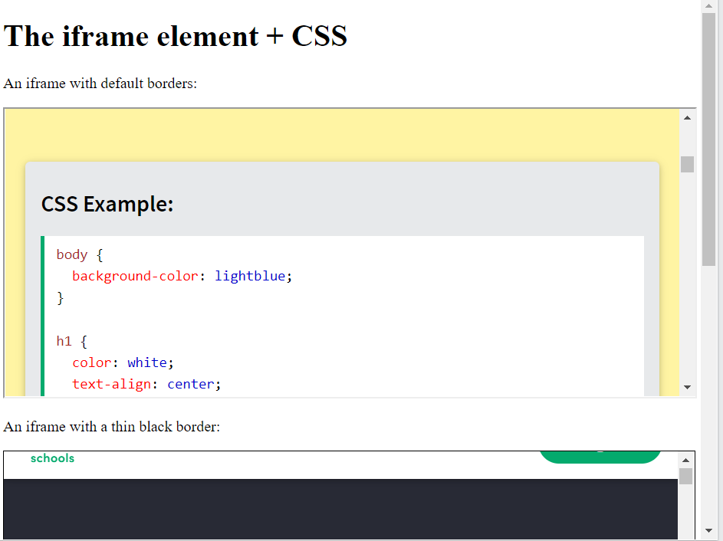

Slide 29
